Slide 1
What is NoSQL?
NoSQL is a non-relational DMS, that does not require a fixed schema, avoids joins, and is easy to scale.
NoSQL database is used for distributed data stores with humongous data storage needs.
NoSQL is used for Big data and real-time web apps. For example, companies like Twitter, Facebook, Google that collect terabytes of user data every single day.
NoSQL database stands for "Not Only SQL" or "Not SQL.“
Traditional RDBMS uses SQL syntax to store and retrieve data for further insights. Instead, a NoSQL database system encompasses a wide range of database technologies that can store structured, semi-structured, unstructured and polymorphic data.

Slide 2
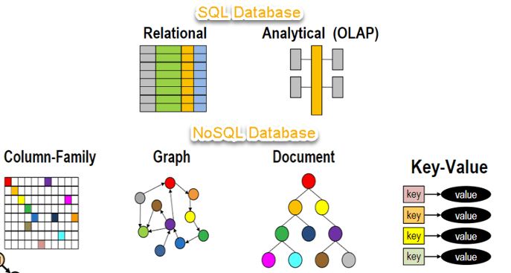
What is NoSQL?

